Slide 1
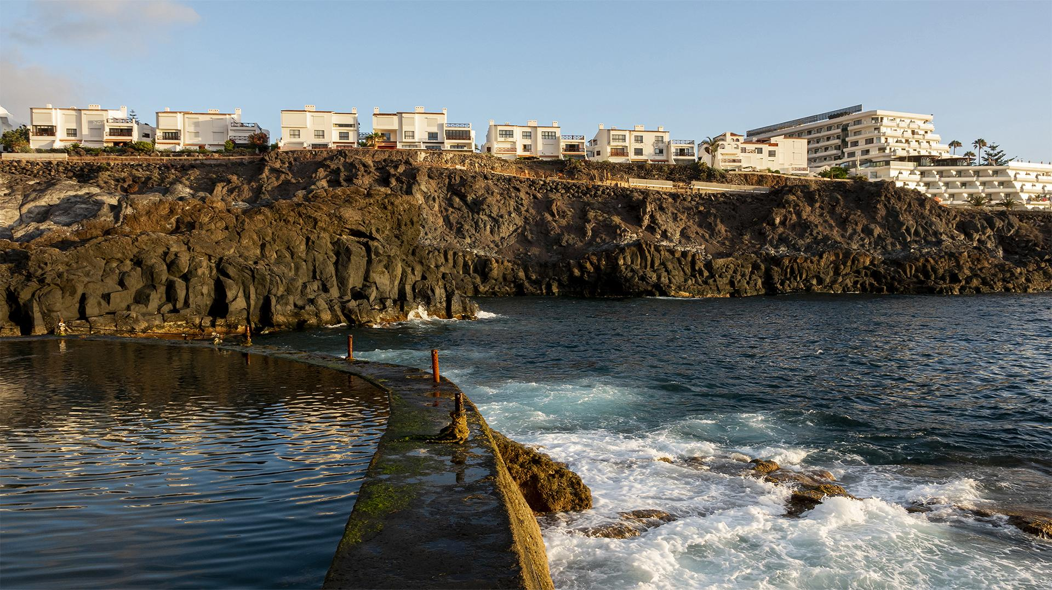
HOTEL LAKECHORE
A Project On Lakeshore Online Hotel Management System
· SINCE 2022·

Slide 2
A Project On Lakeshore Online Hotel Management System Supervised By: Dhonita Tripura Lecturer Department of CSE RMSTU Submitted By: MD. AL-Mamun Bhuyian Reg. No : 2015-12-24

Slide 3
HOTEL CHAIN
TABLE OF CONTENTS
·04· Requirement Specification
·07· Limitations
·08· Future Work
·05· Designing & Planning
·09· Website Screenshot
·06· Implementations Details
·01· Introduction
·02· Existing System
·03· Proposed
System

Slide 4
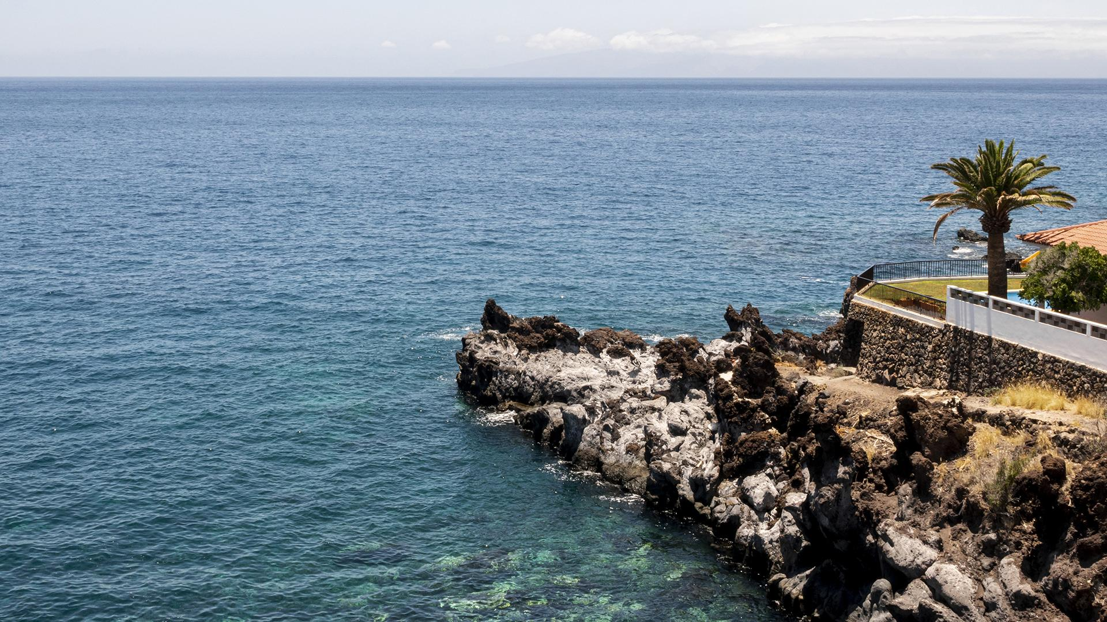
·01· Introduction
SINCE 1930
The project “Lakeshore Online Hotel Management System” is a system based on accessing the internet to book for rooms in a hotel. The purpose of this study is to develop and implement an online hotel reservation system for hotels, that will replace the manual method of booking for hotel rooms. The previous system for booking rooms were faced with so many problems like, delay in processing the customer booking or paying for rooms that is below or beyond his standard, causes difficulty for emergency booking.
The objects-oriented analysis and design methodology (OOADM) was therefore used to analyse the system in order to discover the various objects involved and how they interact with one another so that a new and improved system can be defined.
The use of online view of room rates and uploading of available rooms and facilities was used for the new system so that the customer can view and make his choice before arrival, and also in the case of emergency travelling. This new system assisted the hotel owners in managing their hotels, because they can also regulate the receptionist moves and avoid fraudulent activities. It also increased the efficiency of the hotel managers and also their profit margin, once they have a better and good facilities.

Slide 5
HOTEL CHAIN
Existing System In the existing system, only provides the information about particular hotel and only some of the hotels has possibility to reserve the rooms. The previous system was failure to publish the room’s availability of multiple hotels. And, it is failure to provide defence to admin and user information.
SINCE 1930

Slide 6
HOTEL CHAIN
Proposed System A Lakeshore Online hotel management system provides the quality service to the end user. This project aims at creating on Hotel Management System which can be used by Admin and Customers. The admin to advise/publish the availability of rooms in different hotels and customers are checking the availability of room in required hotel. Customers should be able to know the availability of the rooms on a particular date to reserve in hotel room. They should be able to reserve the available rooms according to their need in advance. To make their stay comfortable. The Admin hands the booking information of customers. The users can register and log into the system. The administrator will know the details of reservation and daily income. only provides the information about particular hotel and only some of the hotels has possibility to reserve the rooms. The previous system was failure to publish the room’s availability of multiple hotels. And, it is failure to provide defence to admin and user information.

Slide 7
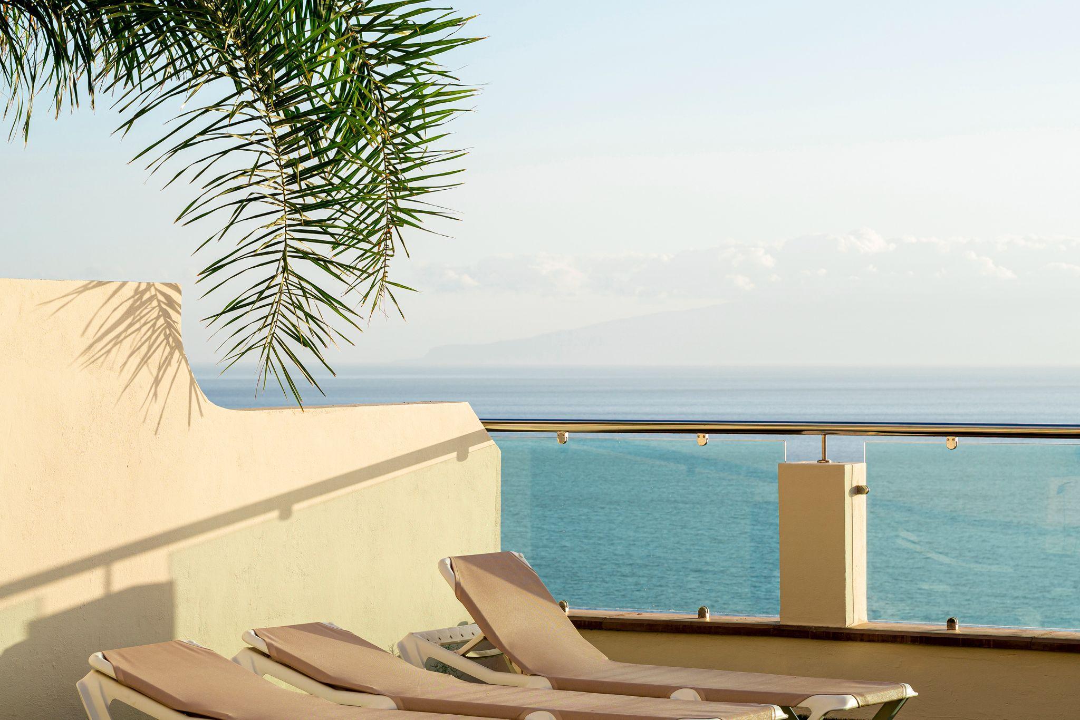
Requirement Specification
Hardware Requirement
Number | Description
1 | 1 pc with 250 GB or more Hard disk
2 | 2 GB RAM
3 | PC with Pentium 1 and above
Software Requirement
Number | Description
1 | Operating System | Windos XP/Windows
2 | Language | PHP
3 | Database | MYSQL
4 | IDE | Visual Code
5 | Browser | Google Chrome

Slide 8
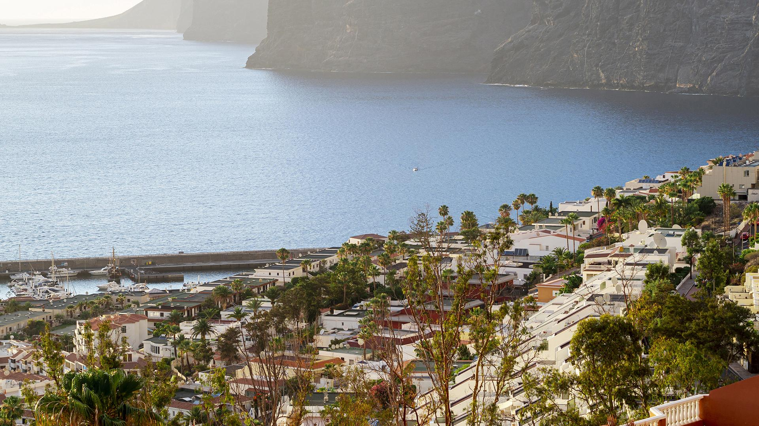
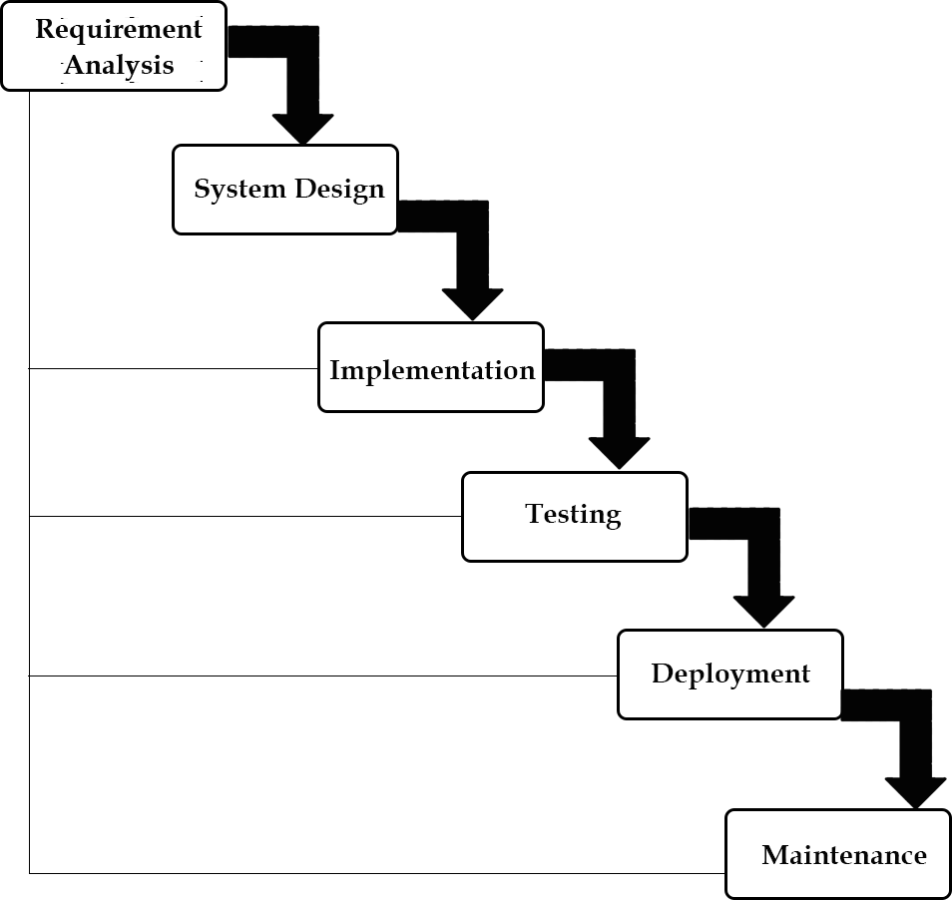
Designing & Planning WATERFALL Model

Slide 9
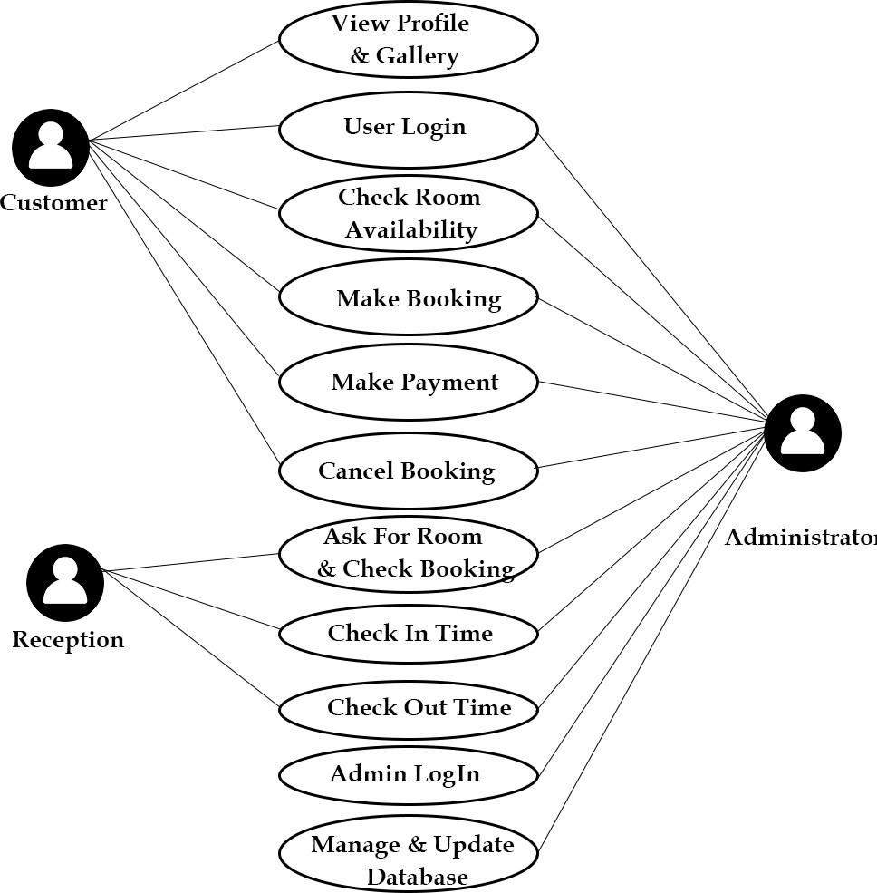
Designing & Planning USECASE DIAGRAM

Slide 10
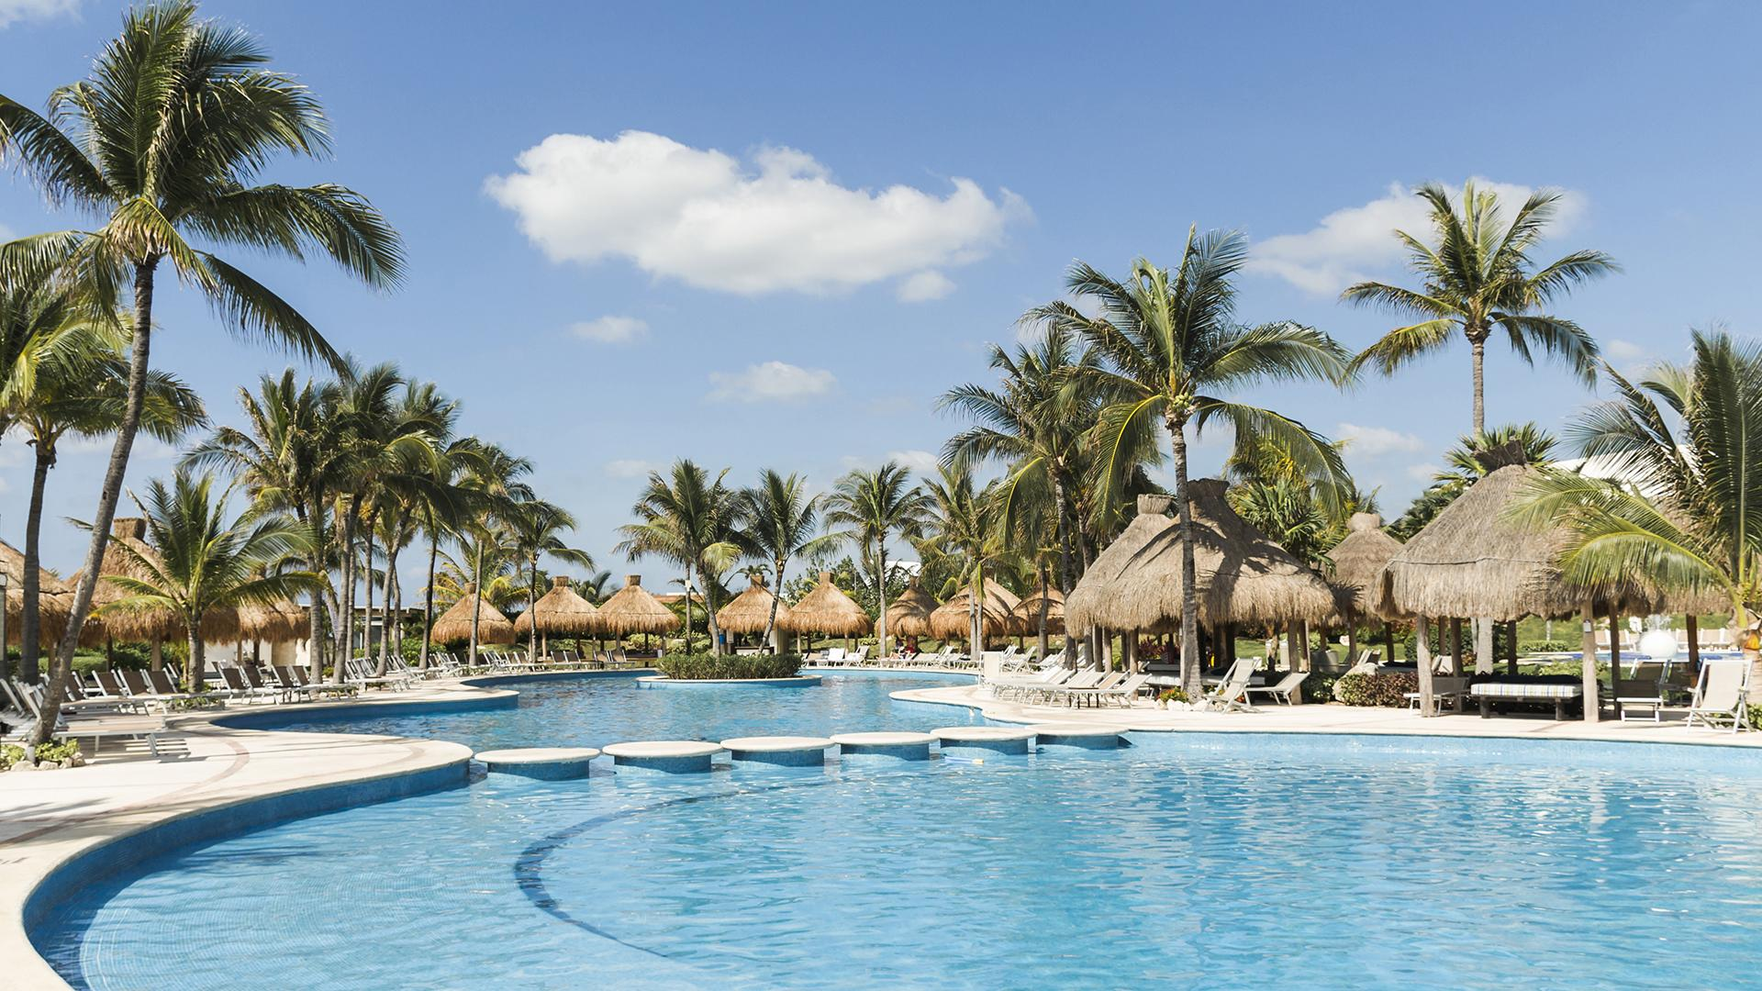
Implementations Details
HOTEL CHAIN
Front-End Implementations
Back-End Implementations
1.PHP
2.XAMPP
3.MYSQL
1.HTML
2.CSS
3.JAVASCRIPT
4.JQUERY
5.BOOTSTRAP
6.GITHUB

Slide 11
LIMITATIONS
A Lakeshore online hotel management system is a very big project which may be updated day by day. In Future by developing new feature it’s may need add new section .Every project has its limitations, and my project also has some limitations given in below:
Not connected to live server. Now without domain hosting it’s can not open with online server.
Cash on delivery. Online Payment system like ATM card, Visa Card, Master Card, Rocket or Bkash Mobile Banking can’t possible with this system.
No mobile application created. A hotel Management System it’s a web application. It’s not have a mobile application.
Not easily converted any user interface Language. Example it’s make in English user interface Language, so if any one want to change his/her own mother tounge language it’s not possible.
Discount or coupon System not added.

Slide 12
Future work
The possible improvements that can be made for the Lakeshore Online Hotel Management System include: I can make the graphical user interface friendlier and more functional in the next development. The Lakeshore Online Hotel Management System aims to provide a user-friendly interface and more functions for real world hotels. But there is still some room for improvements. For example, I can change the settings and functions of some options in the Web pages to make them more professional and artistic. I can also use more pop-up windows so that users can choose the value from them directly. This applies to "arrival date" and "departure date" options. In this way the users can avoid many possible mistakes caused by inappropriate input. This online system only allows users to make a reservation that date is within one year and reserve up to seven rooms per visit. These limitations can be removed in the future. In future improvements, the Online Hotel Booking System can offer more services such as car rental, flight ticket purchase, and the vacation package advising. These services have been offered already on some real world online booking systems. More hotels will add these services on their online systems. In this way, people can make all their requests at once no matter they are business trip arrangement, shopping, travel, or vacation.

Slide 13
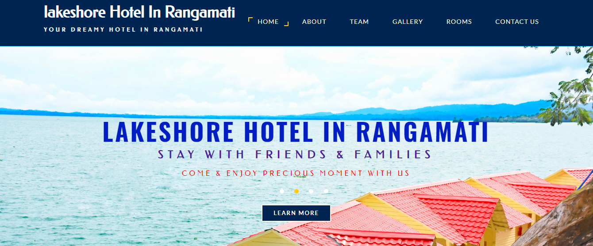
Website screenshot
Home page

Slide 14
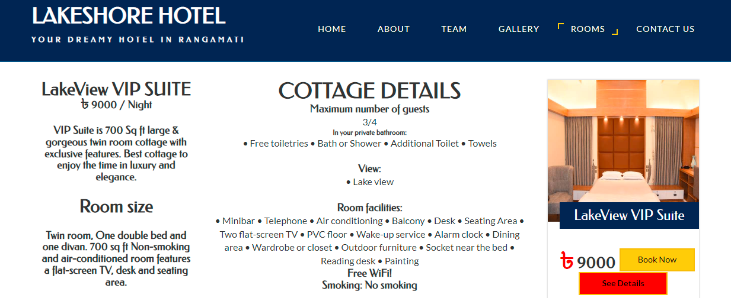
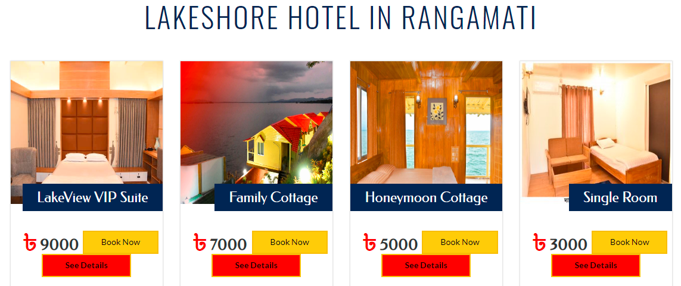
Website screenshot
Details page

Slide 15
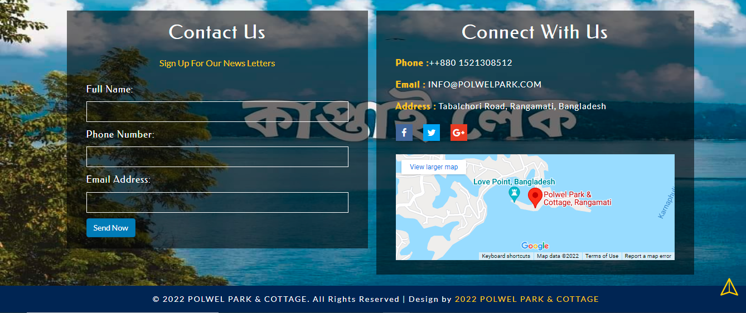
Website screenshot
contact page

Slide 16
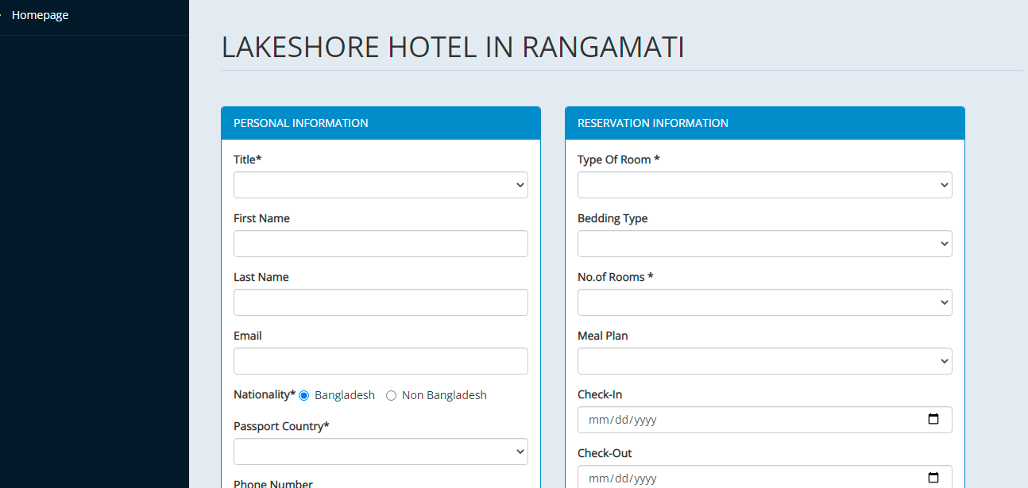
Website screenshot
Booking page

Slide 17
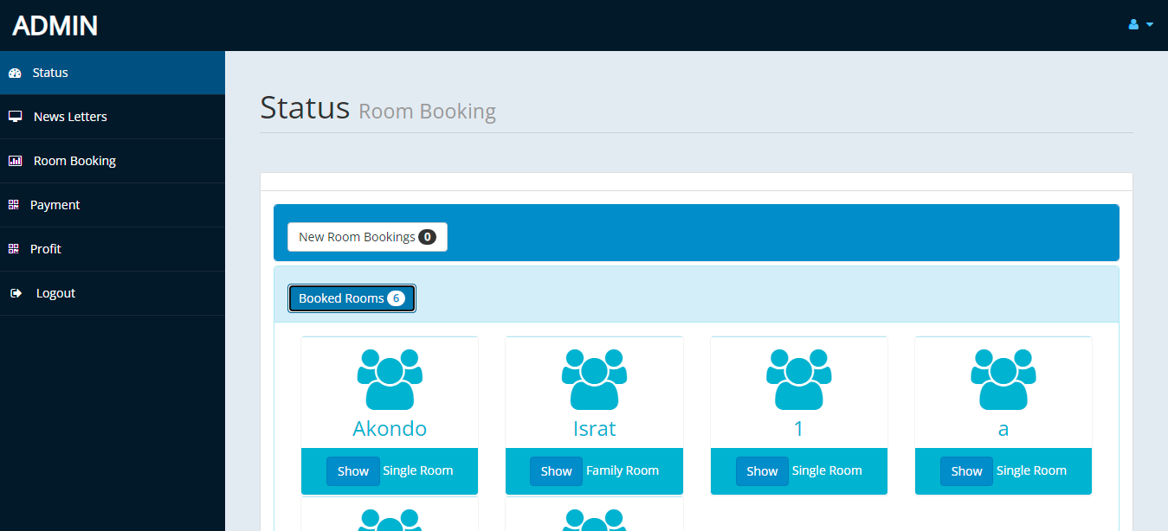
Website screenshot
admin page

Slide 18
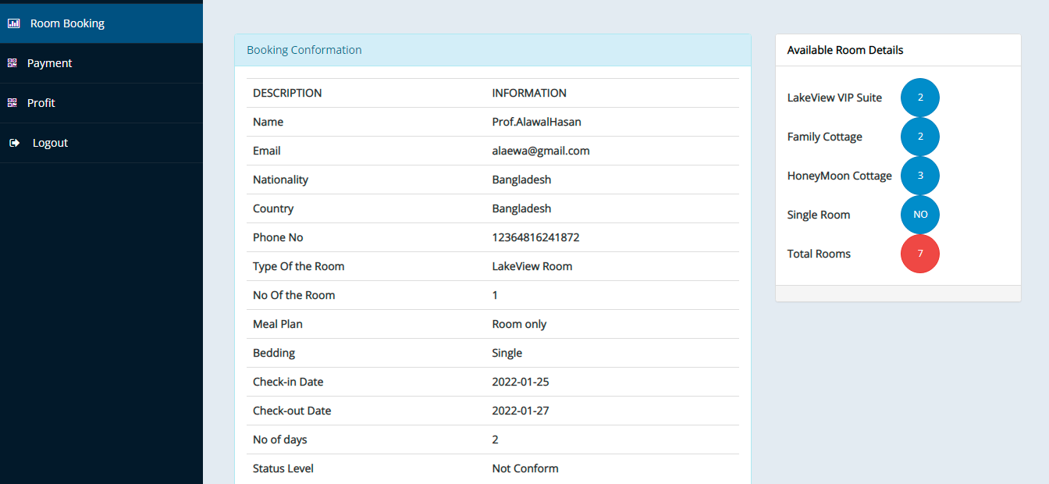
Website screenshot
confirmation page

Slide 19
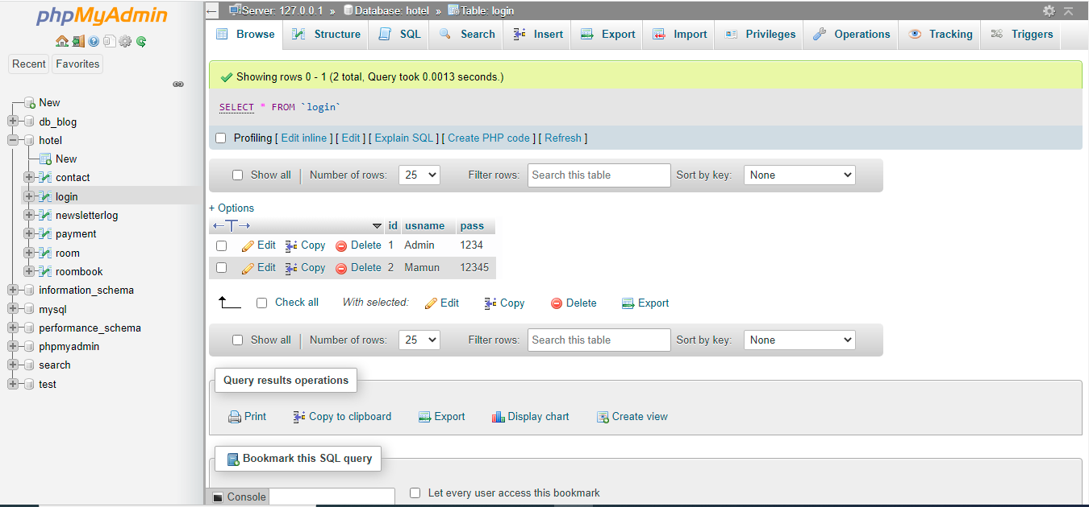
Website screenshot
database page

Slide 20
THANKS!

